Slide 1
Summary of Update meetings
This presentation contains a brief overview of
the steps and the tools
Errors I had while testing the pipeline and brainstorming ways to troubleshoot
Some of the initial results
Aakanksha Singh

Slide 2
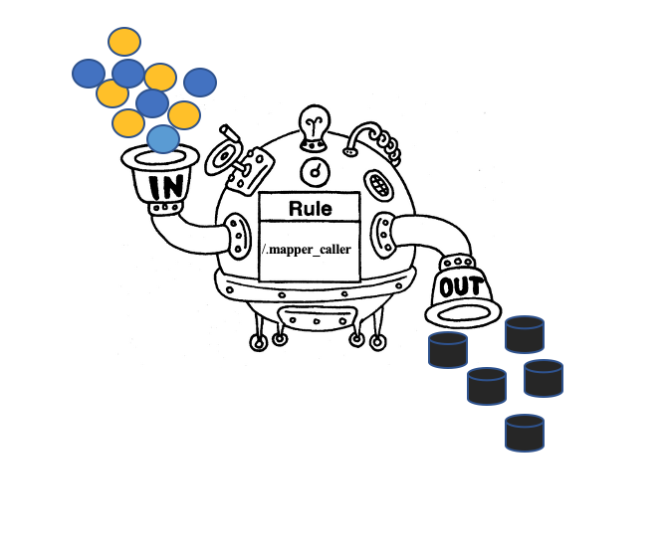
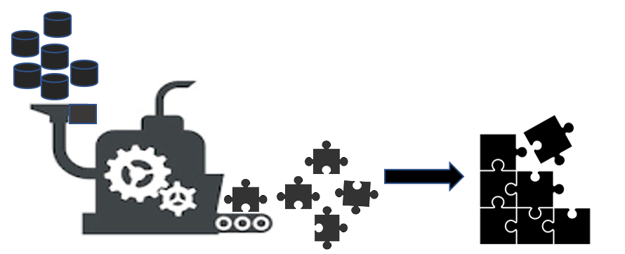

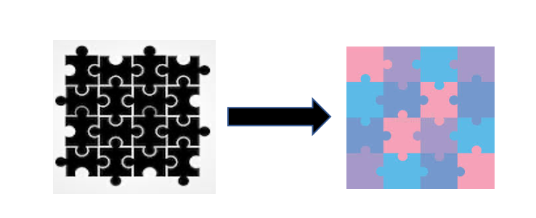
From Fastqs to Bams
From Bams to one giant VCfs
Variant calling and annotation
Filtering
mapper_caller
Gatk_master_script
Producing_a_vcf_from_bam()

Slide 3
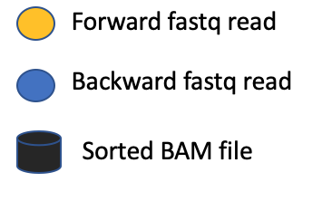
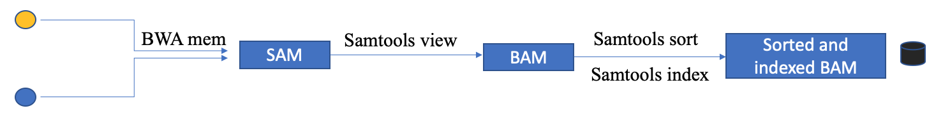
From Fastqs to Bams
From Bams to one giant VCfs
Variant calling and annotation
Filtering
mapper_caller

Slide 4

From Fastqs to Bams
From Bams to one giant VCfs
Variant calling and annotation
Filtering
Producing_a_vcf_from_bam()
Sorted and Indexed bam file
g.vcf file for one sample
AddOrReplaceRead Groups
MarkDuplicates
Apply BQSR
HaplotypeCaller
BAM.fix
BAM.fix
BAM.fix
Samtools index
Samtools index
Samtools index
CreateSequenceDictionarty
BaseRecalibrator
bam.dict
bam.passe1.table

Slide 5

From Fastqs to Bams
From Bams to one giant VCfs
Variant calling and annotation
Filtering
Producing_a_vcf_from_bam()
Sorted and Indexed bam file
g.vcf file for one sample
GenomicsDBImport
A merged vcf file

Slide 6
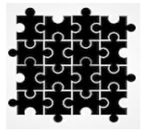

From Fastqs to Bams
From Bams to one giant VCfs
Variant calling and annotation
Filtering
Gatk_master_script
Genotype GVCF
Variant Recalibration
Apply VQSR
SnpEff
VCF
VCF
VCF ready for annotation
Bcftools annotate

Slide 7

From Fastqs to Bams
From Bams to one giant VCfs
Variant calling and annotation
Filtering
Gatk_master_script
VCF selected for SNPs and Indels
VCF with high quality variants
Select Variants
VariantFiltration
Apply VQSR
Annotated vcf
True indels and snps

Slide 8
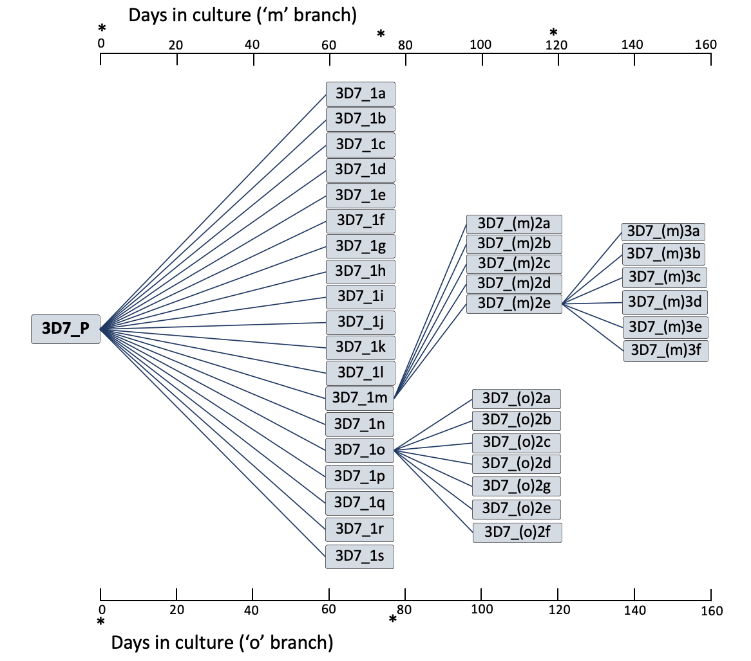
3D7 Clone Tree

Slide 9
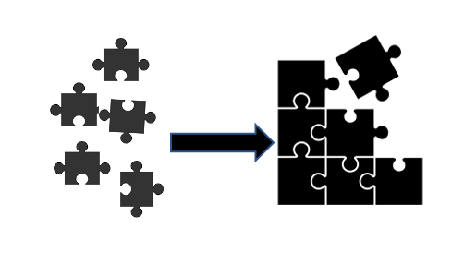
Where I am right now
From Fastqs to Bams
From Bams to one giant VCfs
Variant calling and annotation
Filtering
Genomics DB Import
Multiple g.vcf files
Combined g.vcf files

Slide 10
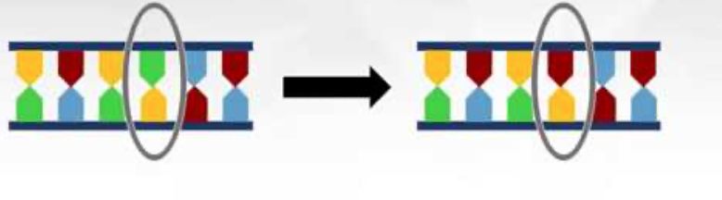
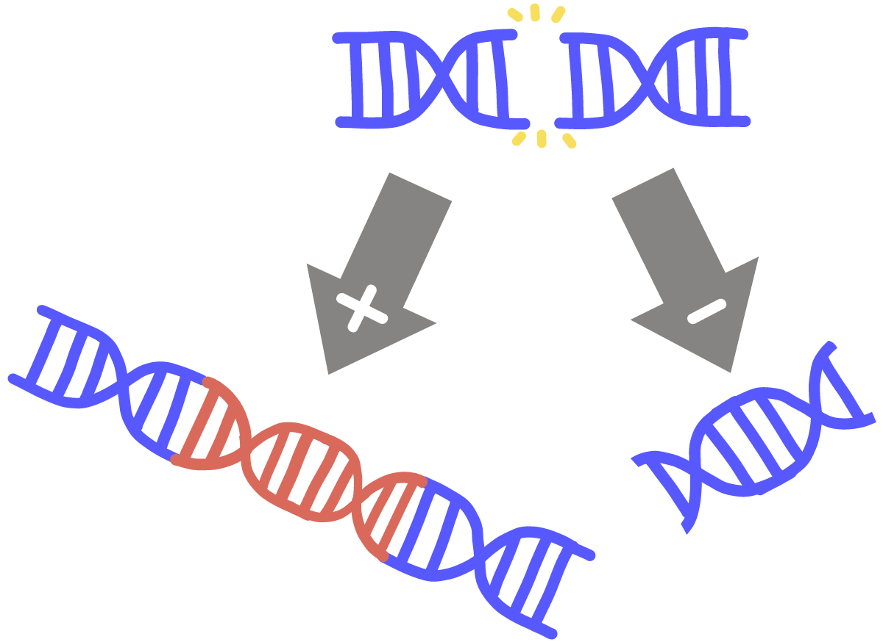
Immune system evasion in Plasmodium
SNPs
INDELS

Slide 11
SNP filtering
GATK
DISCOVARIF
3D7 first gen
195 filtered variants (SNPs and short indels)
97 variants with Qual score 99999
32 variants with alt/alt+ref ratio > 9
All the 12 indels found in Hamilton 2016 present.
There may be 2 new SNPs
3D7 second gen
20308 filtered variants.
All variants have qual score 99999
3 that match with Hamilton 2016 present.
3D7 first gen
After annotation, 66497 variants.
After, Gatk SelectVariants (SNPS, INDELS, BIALLELIC), 55509 variants
After, Gatk VariantFiltration , [(VQSLOD <=0.0), QUAL>1000]
Tried in a variety of combinations, either gives no variants or the same number of variants as in the original file
No infogenome file for W2.
Didn’t start the gatk pipeline for W2 as no known sites.
Do have sorted bam files for W2.
Get sorted with the Gatk filtering.

Slide 12
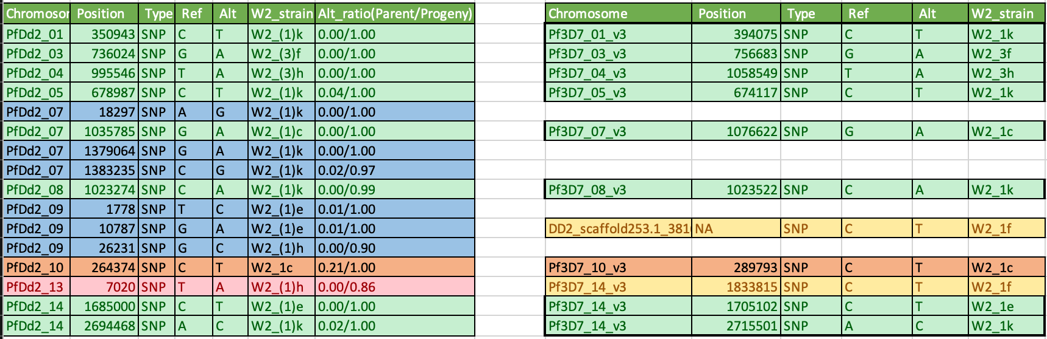
Summary 7th December 2020
W2 SNPS
SNPs that are found in both the cases.
SNPs found in Hamilton 2016 that I did not find.
SNPs found only when W2 mapped to DD2 reference.
This SNP is found in Hamilton 2016 but did not fit my criterion.

Slide 13
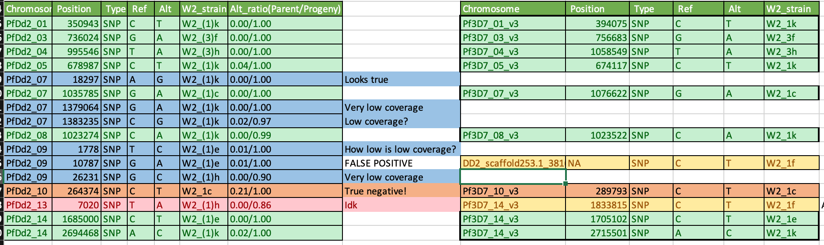

Slide 14
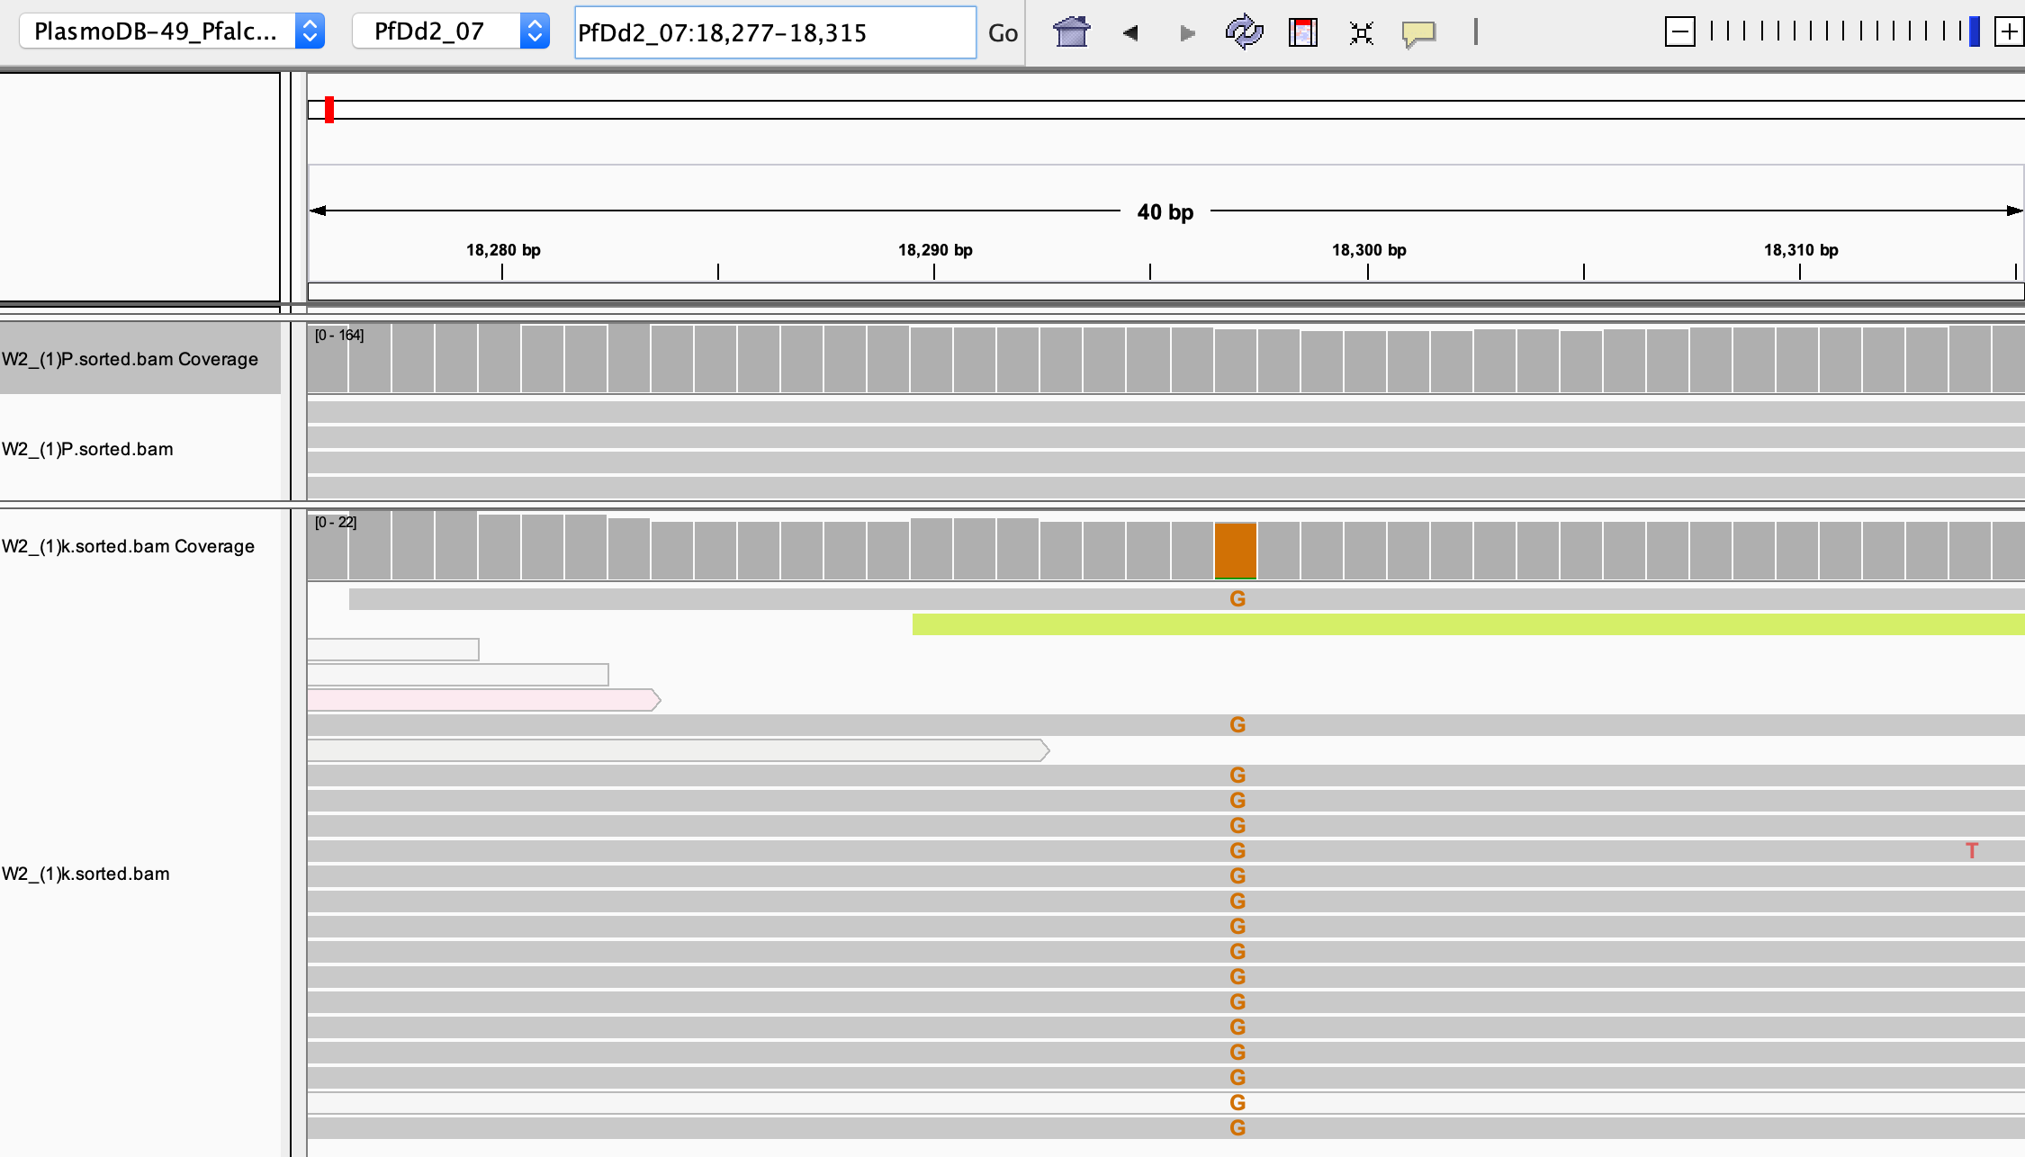
Looks true!

Slide 15
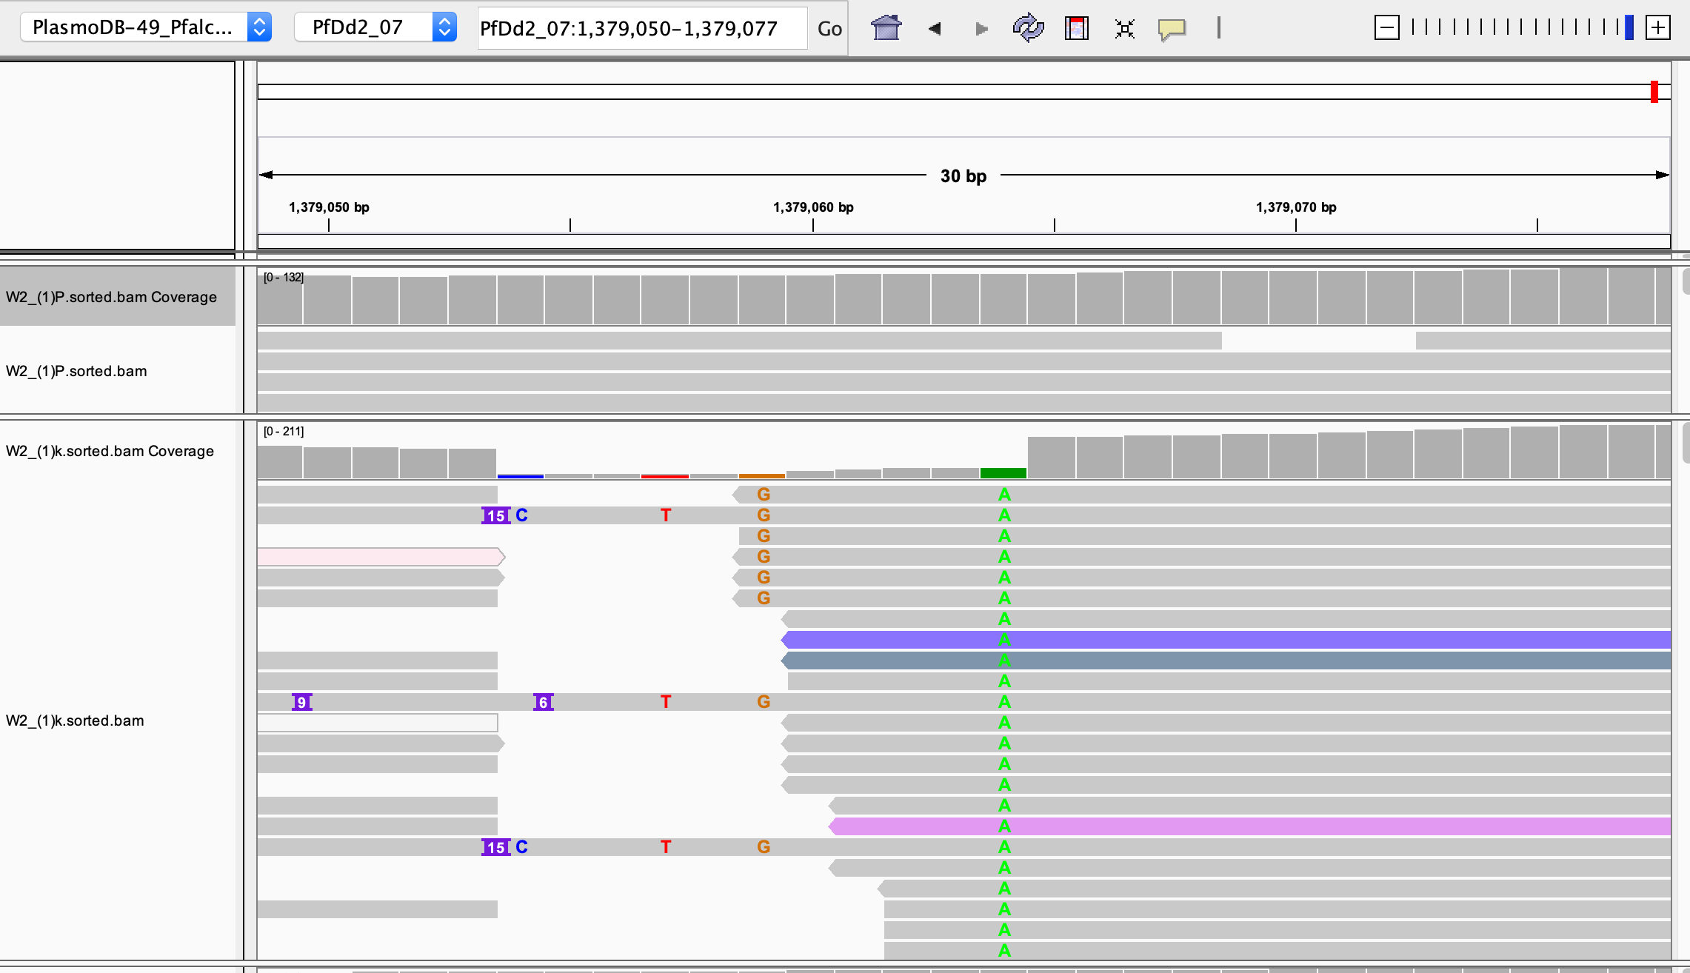
Very low coverage

Slide 16
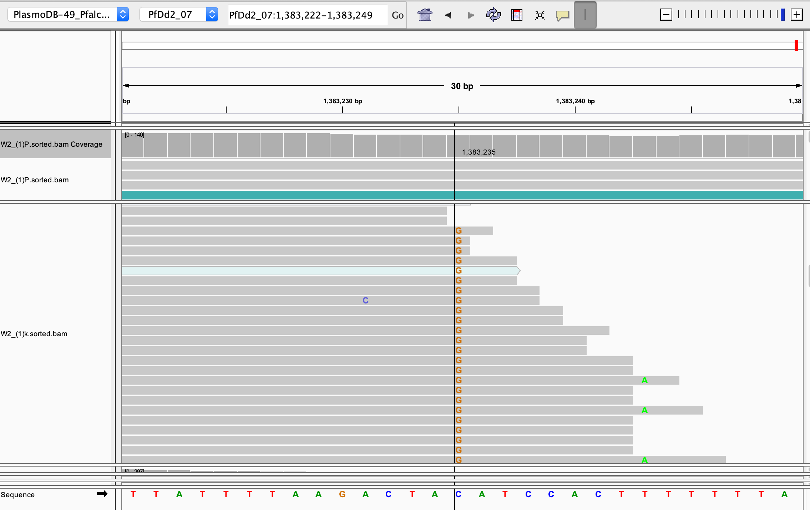
Low coverage?

Slide 17
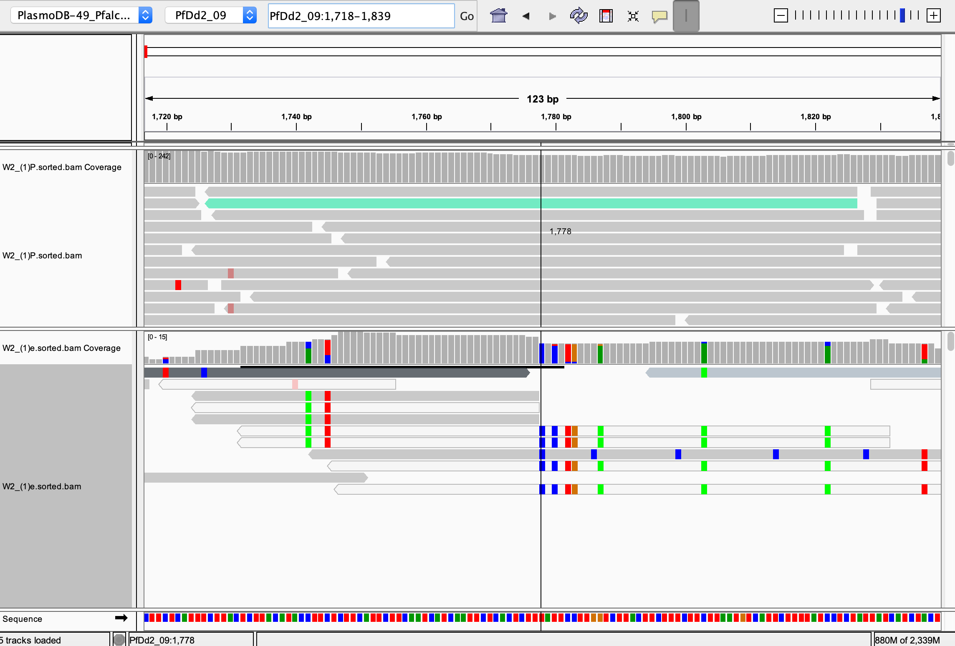
What is low coverage?

Slide 18
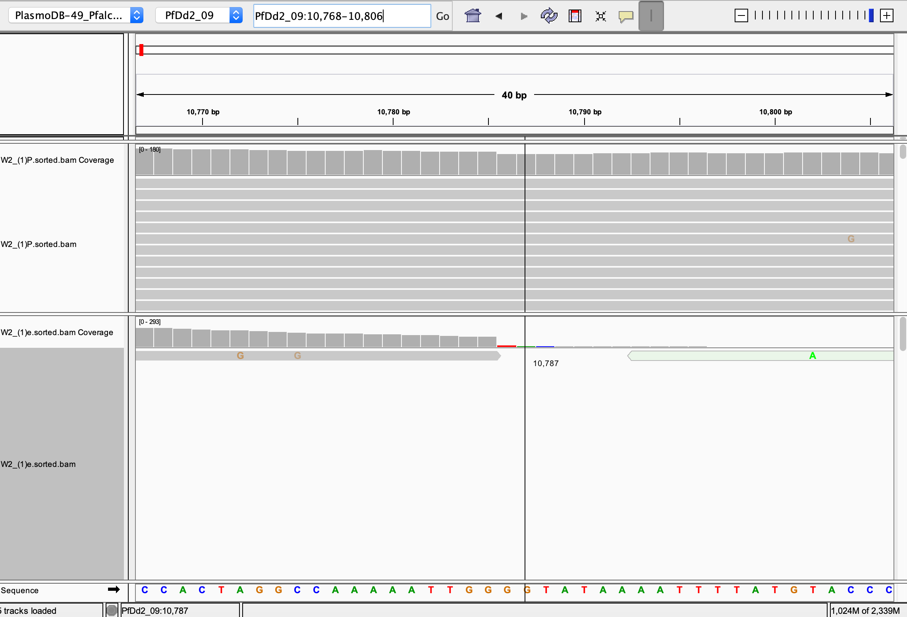
Extremely low coverage
FALSE

Slide 19
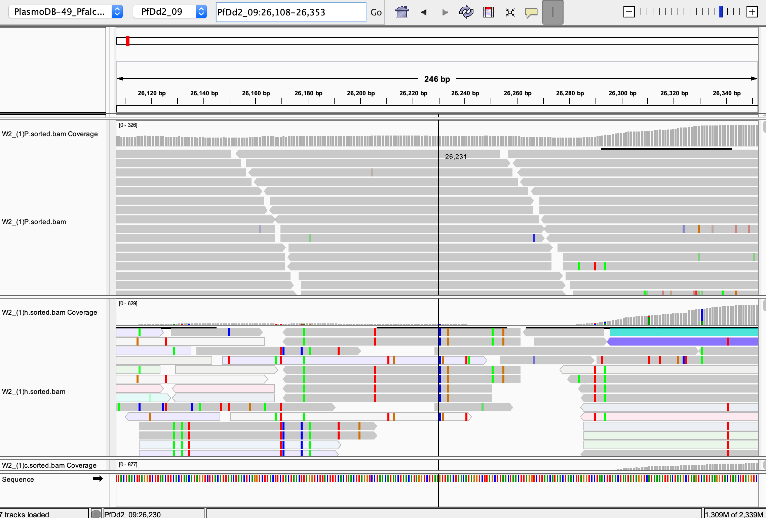
Very low coverage

Slide 20
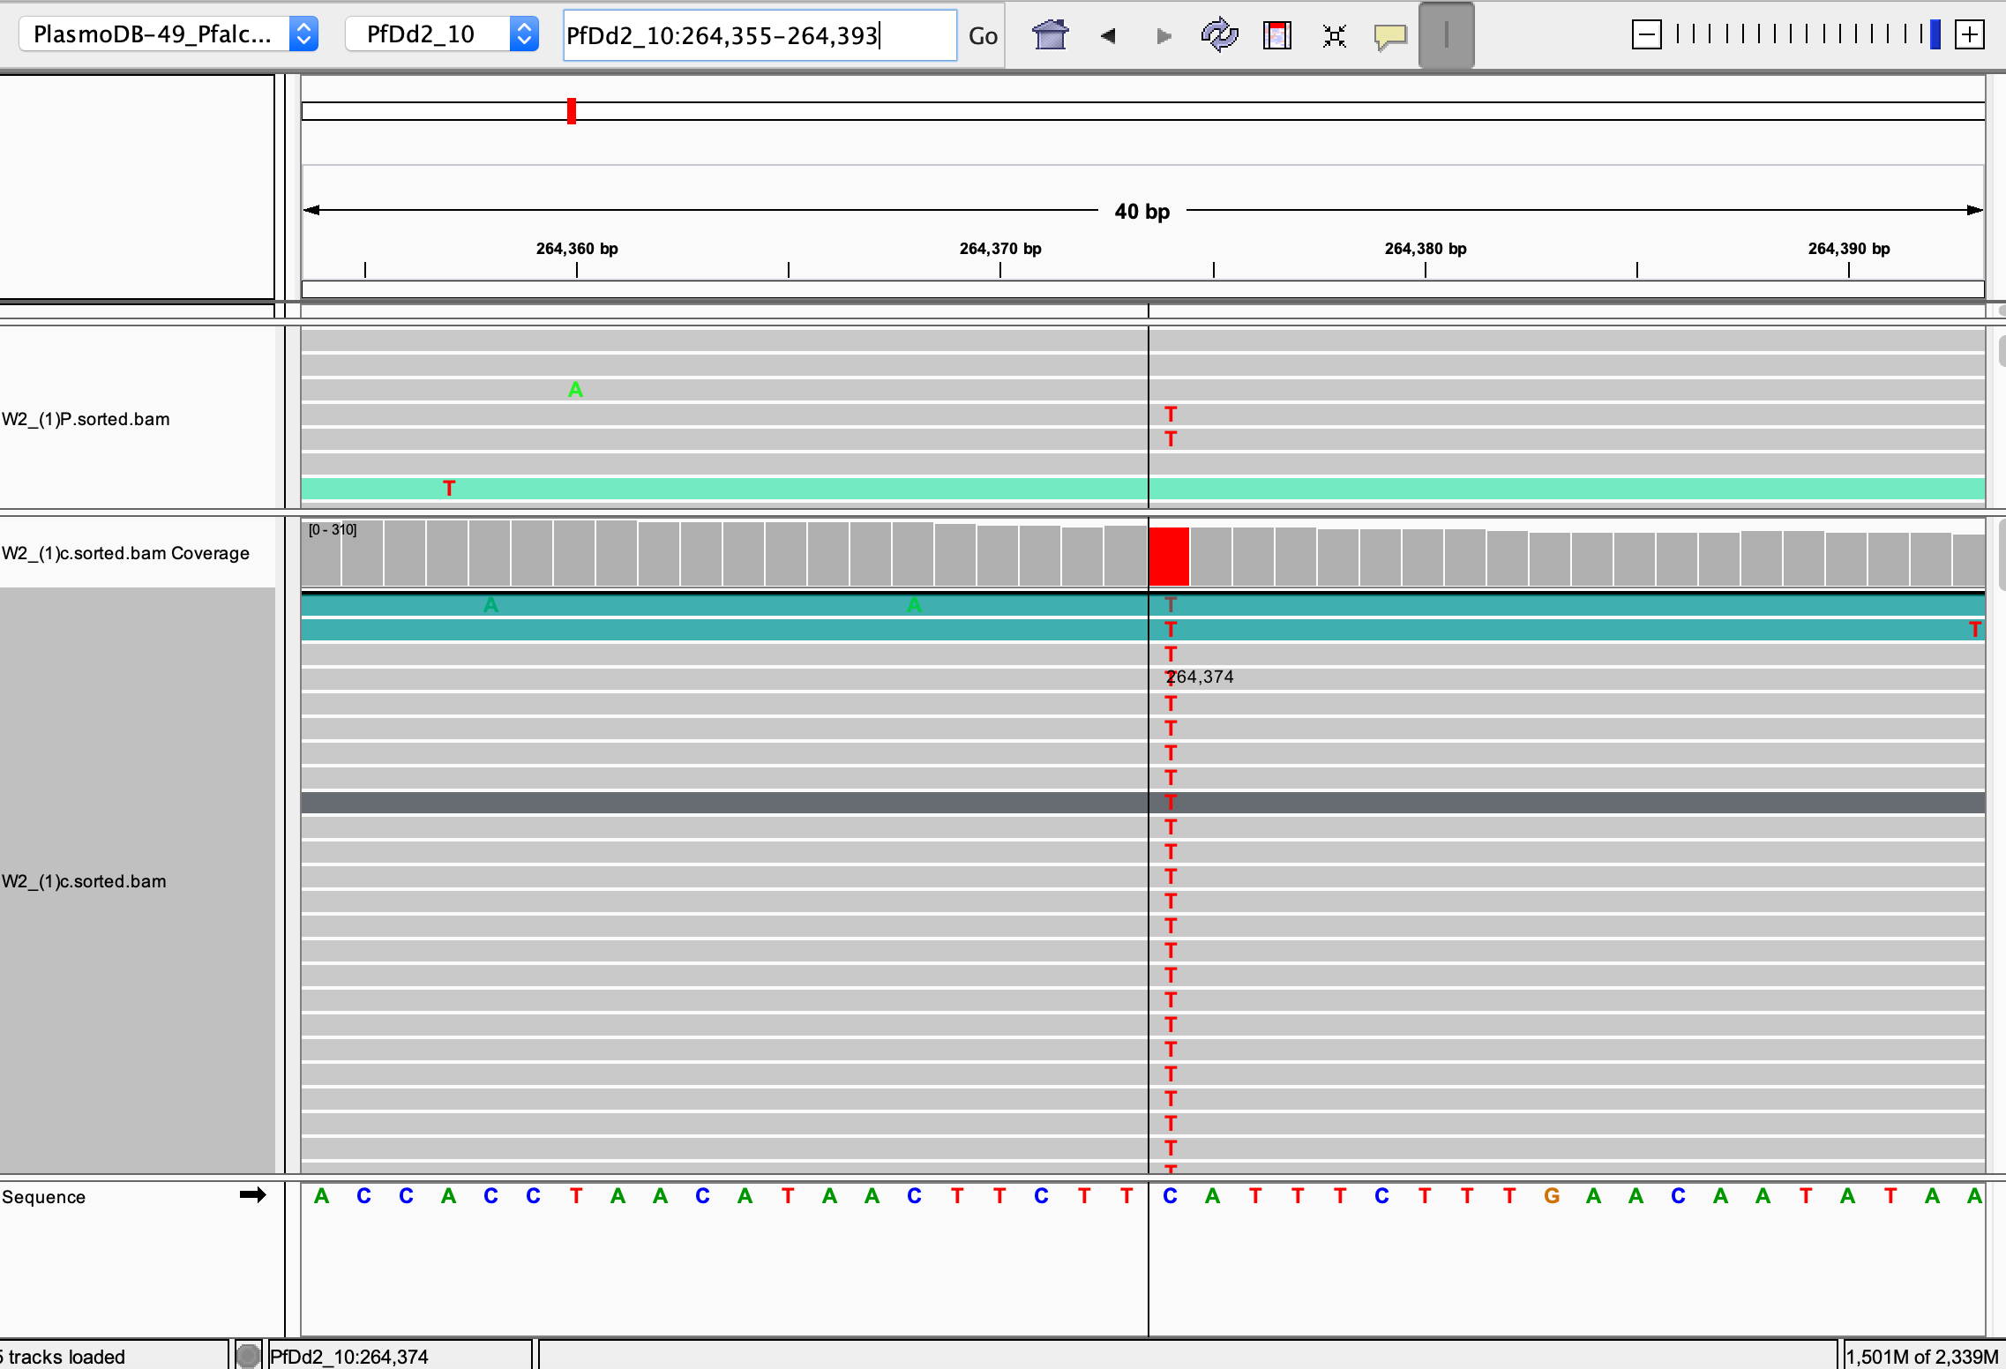
True negative?

Slide 21
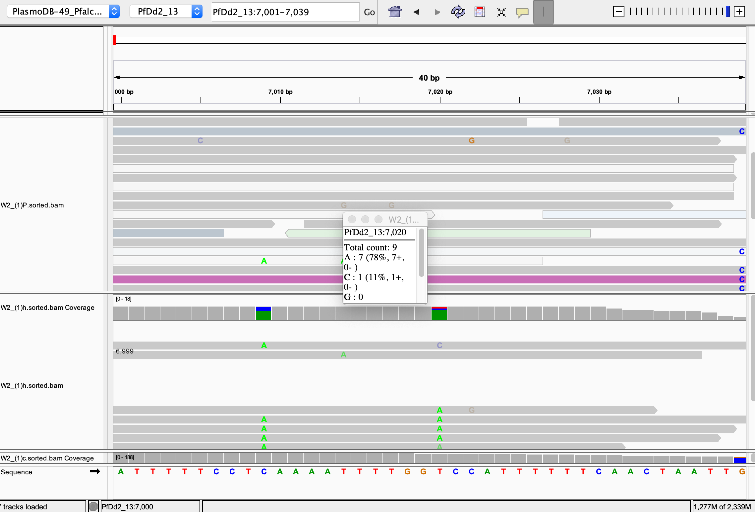
Confused about this

Slide 22
3D7
W2
HB3
Mapping
Mapping
Mapping
Variant calling and filtering
Variant calling and filtering
Variant calling and filtering
DISCOVARIF
GATK
DISCOVARIF
GATK
DISCOVARIF
GATK
Works well for gen1, doesn’t for gen 2

Slide 23
3D7 (34 samples)
Important steps in the pipeline
Tools used in the step
Mapping
No of variants in the respective step
BWA MEM, SAMTOOLS
GATK Pipeline
DISCOVARIF pipeline
With Known sites
Without Known sites
Without Known sites
Data Preprocessing
Data Preprocessing

Slide 24
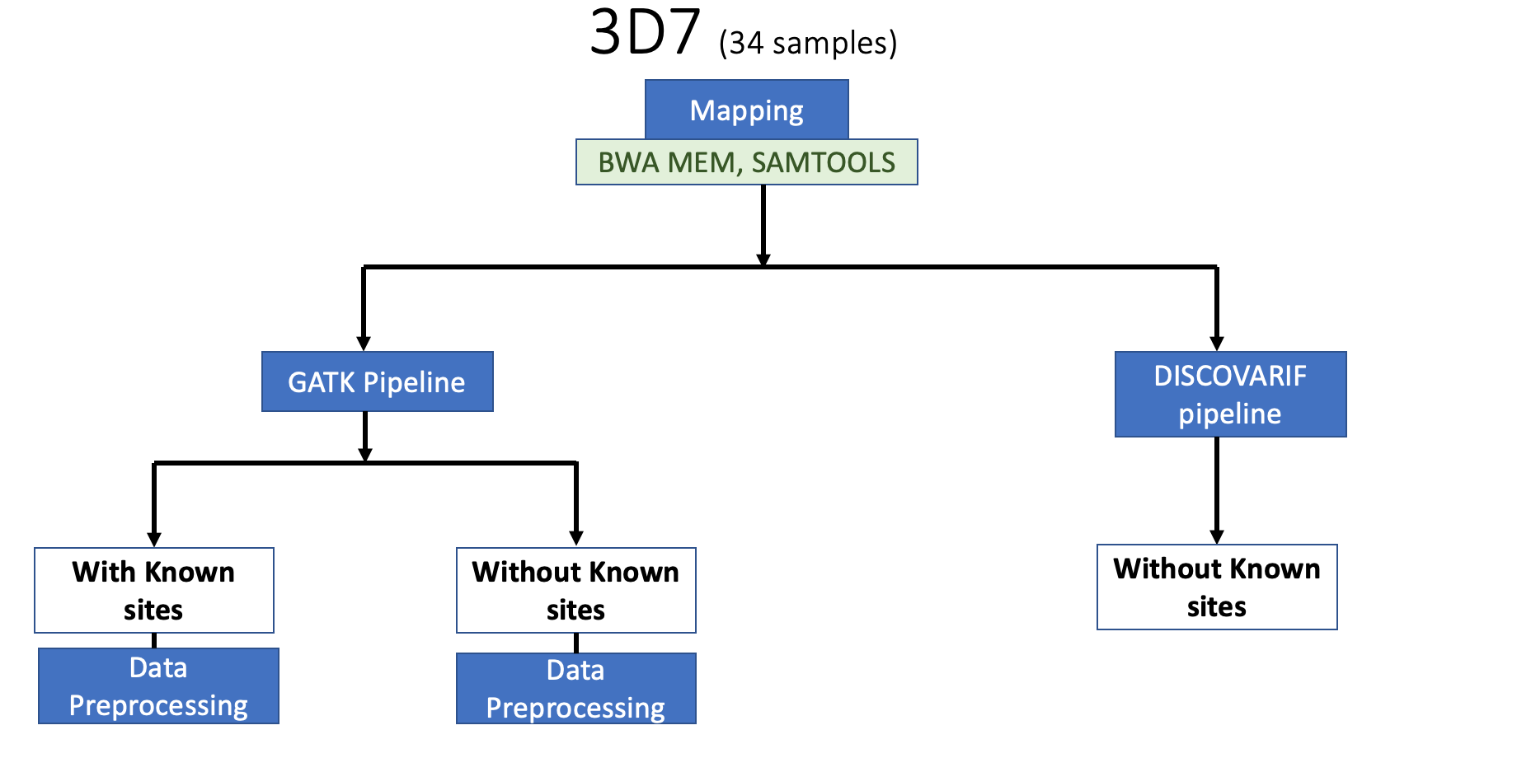
Important steps in the pipeline
Tools used in the step
No of variants in the respective step
Variant calling
Picard Tools( CreateSequenceDictionaries, AddorReplaceGroups)
Samtools
Gatk( BaseRecalibrator, ApplyBQSR)
Picard Tools( CreateSequenceDictionaries, AddorReplaceGroups)
Samtools
BCFTOOLS
( Qual >= 10)
GATK Haplotype Caller
(-max alternate alleles 6)
Gatk HaplotypeCaller
(-max alternate alleles 6)
95435 variants
Variant Filtration
GATK GenomicsDBImport
GATK GenomicsDBImport
Variant calling
VARIFF
(--depth 6 --ratio-alt 0.8 --ratio-no-alt 0.2, BIALLELIC)
Variant calling
GATK GenotypeGVCFs
(-max alternate alleles 6)
GATK GenotypeGVCFs
(-max alternate alleles 6)
18066 variants
108243 variants
140471 variants
15429 SNP
2637 INDELs

Slide 25
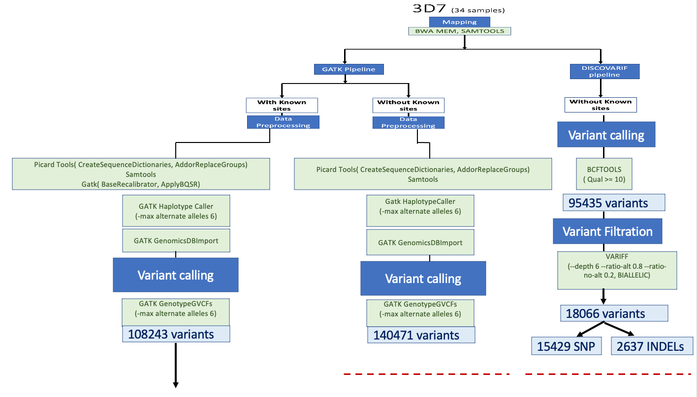
Important steps in the pipeline
Tools used in the step
No of variants in the respective step
GATK VariantRecalibratior
-an QD -an FS -an SOR -an DP
--max-gaussians 2 -mq-cap 70
-mode BOTH
-mode SNP
-mode INDEL
108243 variants
61049 variants
0 variants
GATK ApplyVQSR
--truth-sensitivity-filter-level 99.0
Need to check it out
GATK ApplyVQSR
--truth-sensitivity-filter-level 99.0
Annotation
Annotation
SnpEff and Bcftools
SnpEff and Bcftools

Slide 26
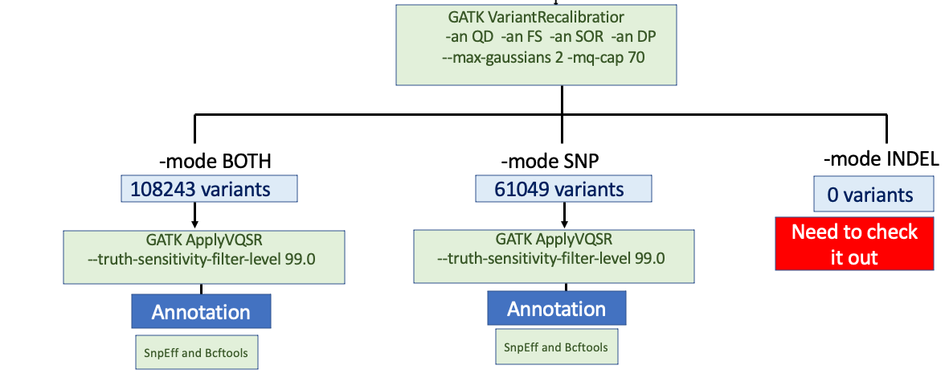
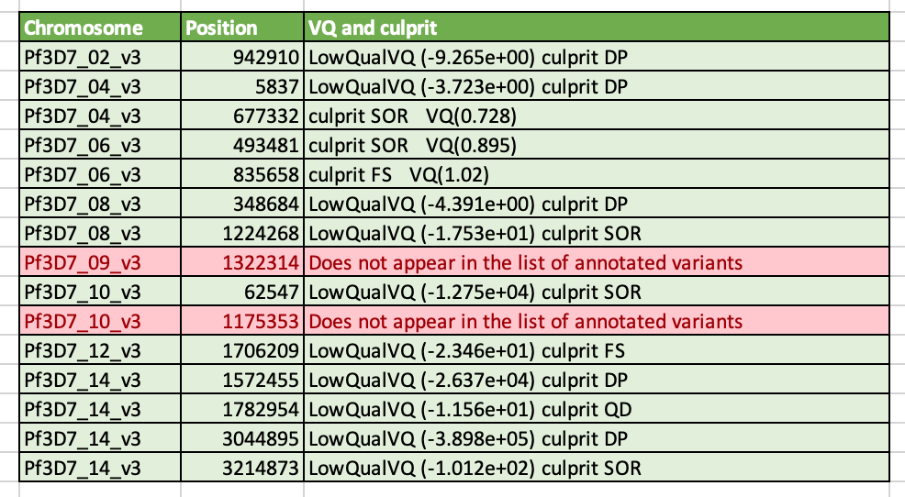
Important steps in the pipeline
Tools used in the step
No of variants in the respective step
Variant_Filtration
GATK SelectVariants
--select type SNP, restrict-alleles-to BIALLELIC,
-select ‘vc.isNotFiltered()
GATK VariantFiltration
-filter “VQSLOD >=0.0’
Filter “RegionType!=Core”
56294 variants
VCFTOOLs
192 variants

Slide 27
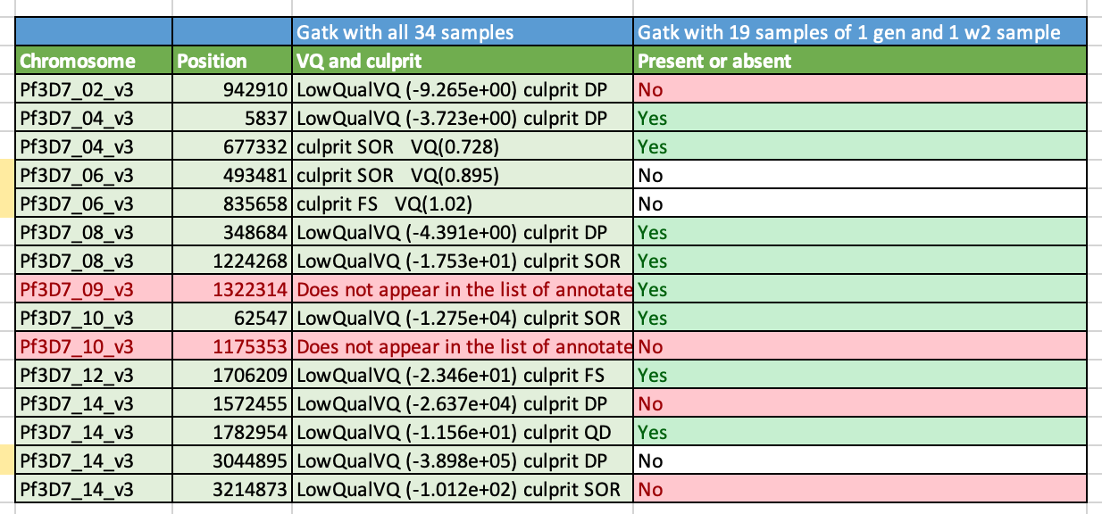
1. Try a ‘mixture’ batch of samples: all 3D7 gen1 plus one W2 BAM file. Run the full pipeline with known sites.
How many True/False variants do you identify?
Weird thing that happens:
During GATK variant Filtration,
-filter "VQSLOD <= 0.0" works and give variants
However
Using
-filter "VQSLOD >= 0.0” gives 0 variants
Samples ( 20)
3D7gen1 + W2_1c
Same pipeline as used for 3D7 Gatk with known sites (mode SNP)
44115 variants
R script that just keep variants where only one sample has GT 1/1 (after removing the w2 sample)
159 variants

Slide 28
2. How many core / non-core variants do you get? What happened to the column indicating the Core / Hypervariable region?
What might be the problem
–c option includes the column names according the Miles 2016 paper, which are CHROM,TO,FROM,RegionType but the vcf contains the columns CHROM and POS ?
Is there a problem with the header of the file (that I created)
##FORMAT=<ID=RegionType,Number=1,Type=String,Description="Type of Genomic region">
##INFO=<ID=RegionType,Number=1,Type=String,Description="What type of region is it">
Command used
bcftools annotate -a /data3/projects/mirage/p_falciparum/3D7_comp/reference/regions-20130225.onebased.txt -h /data3/projects/mirage/p_falciparum/3D7_comp/reference/header.hdr -Ov -o coreregions.vcf -c CHROM,FROM,TO,RegionType annotated.vcf
Have you used the file from Miles 2016 to annotate, did it work well?

Slide 29
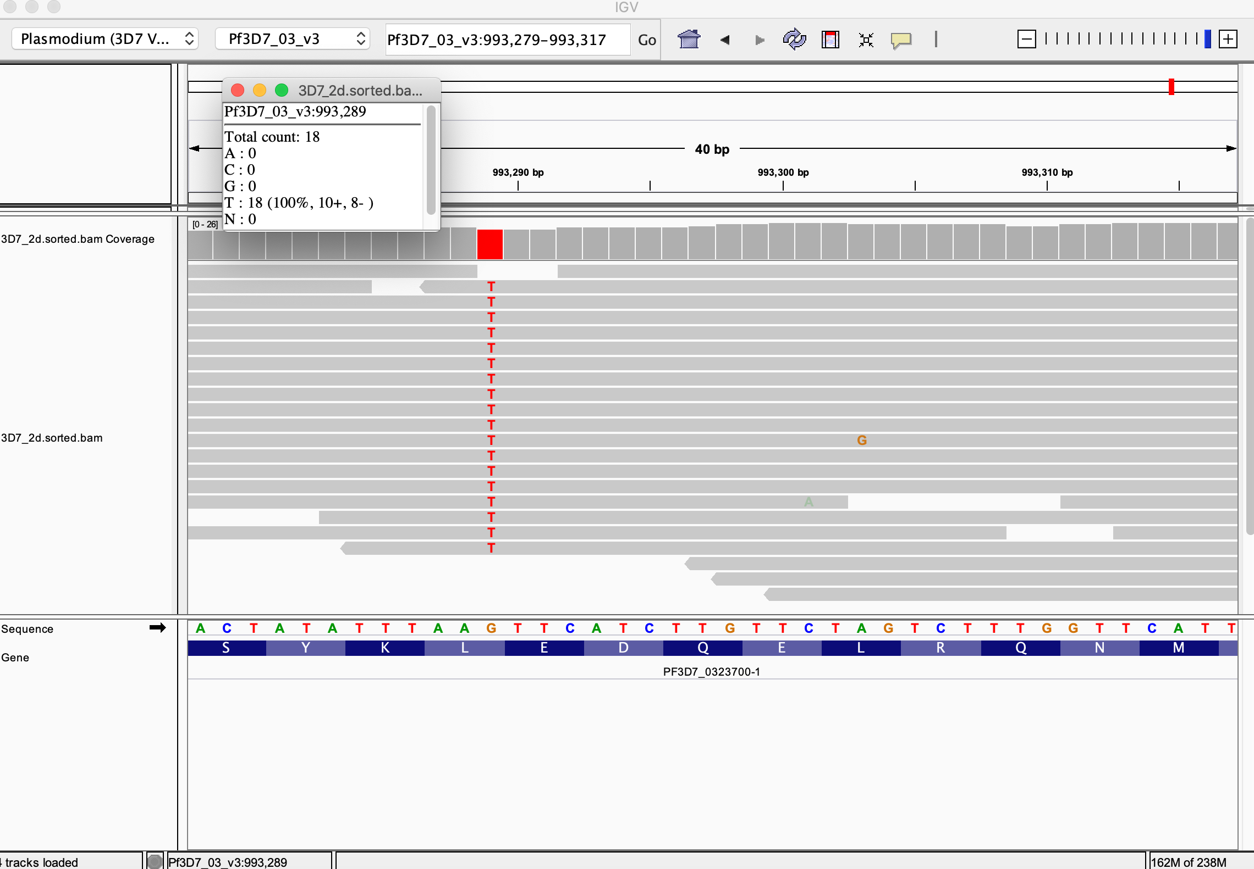
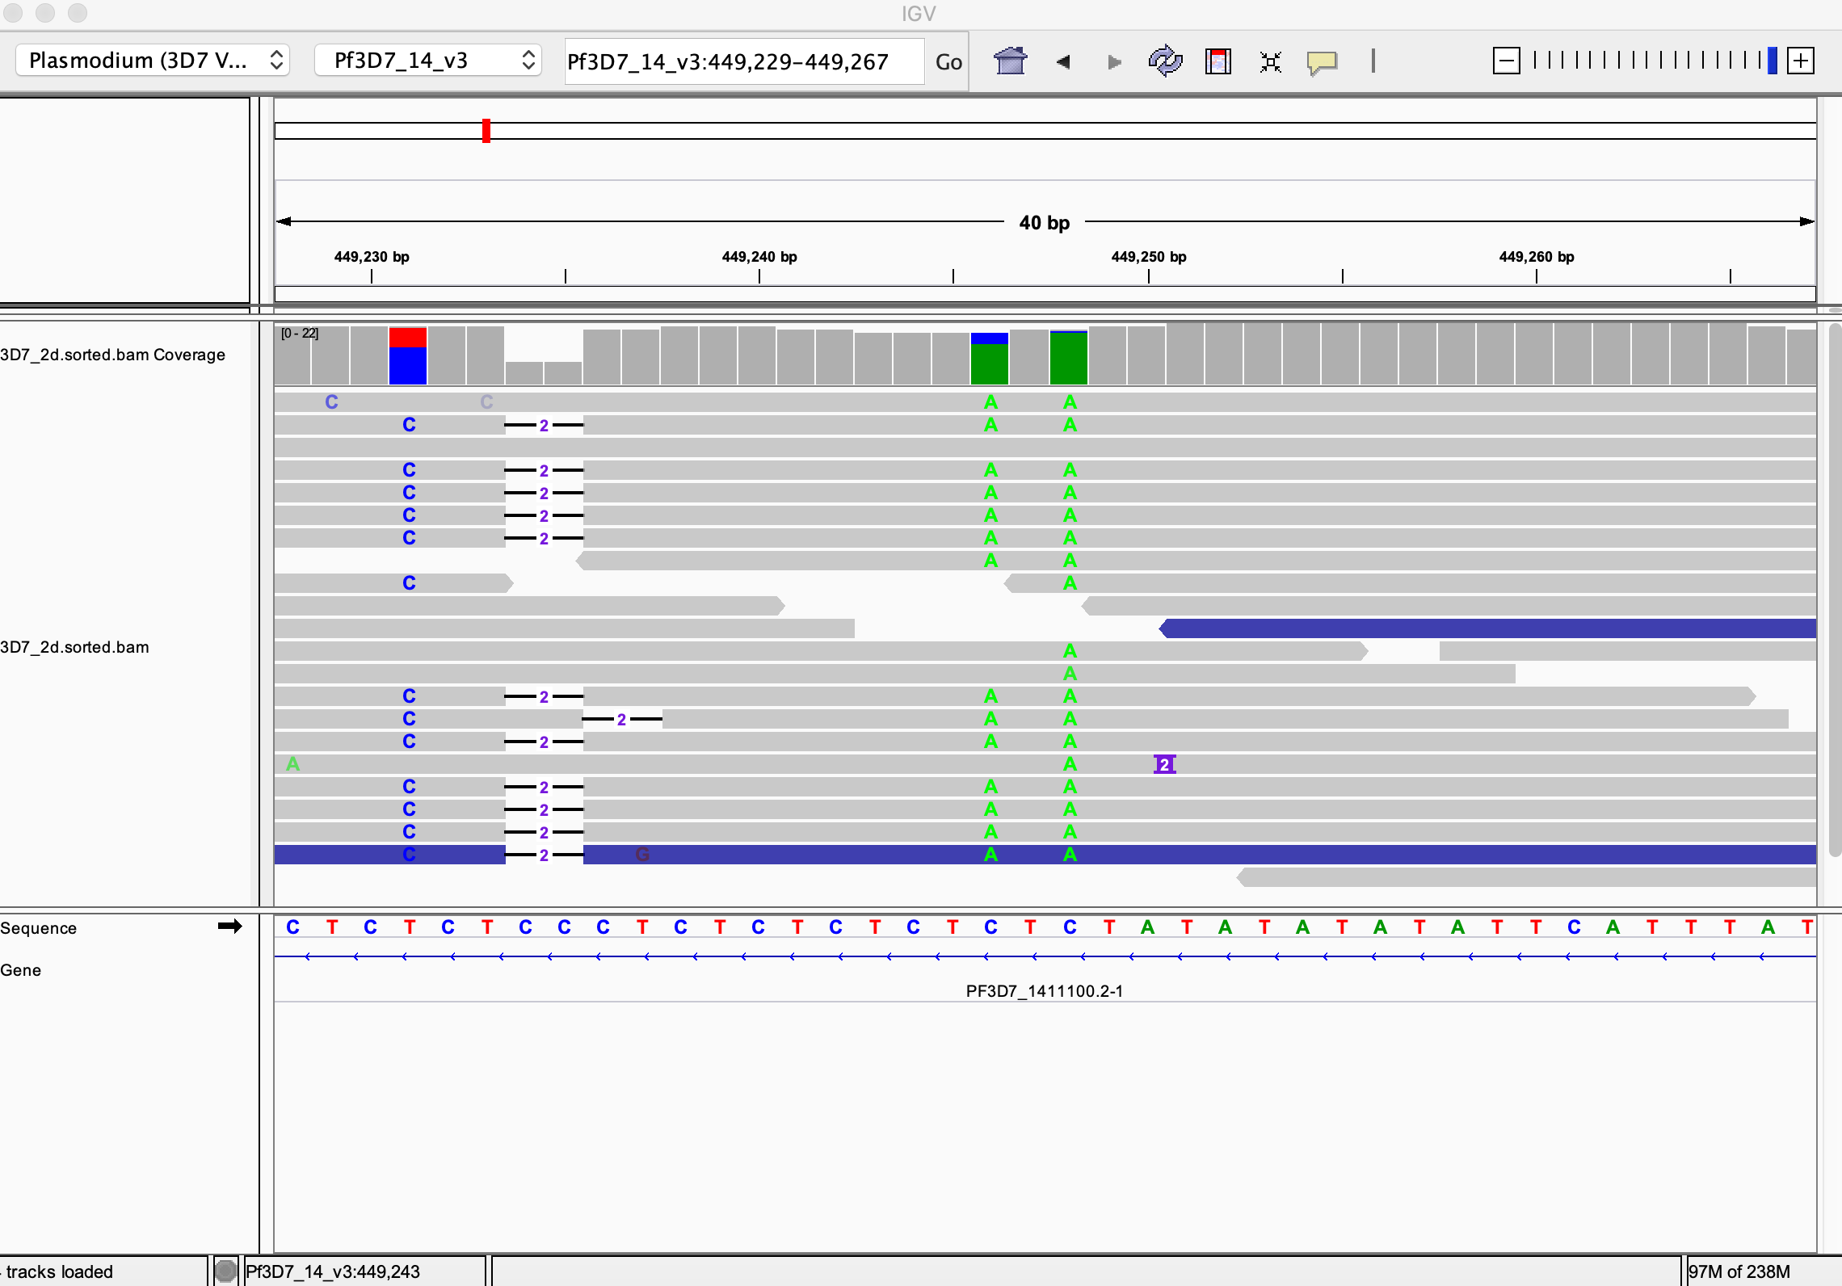
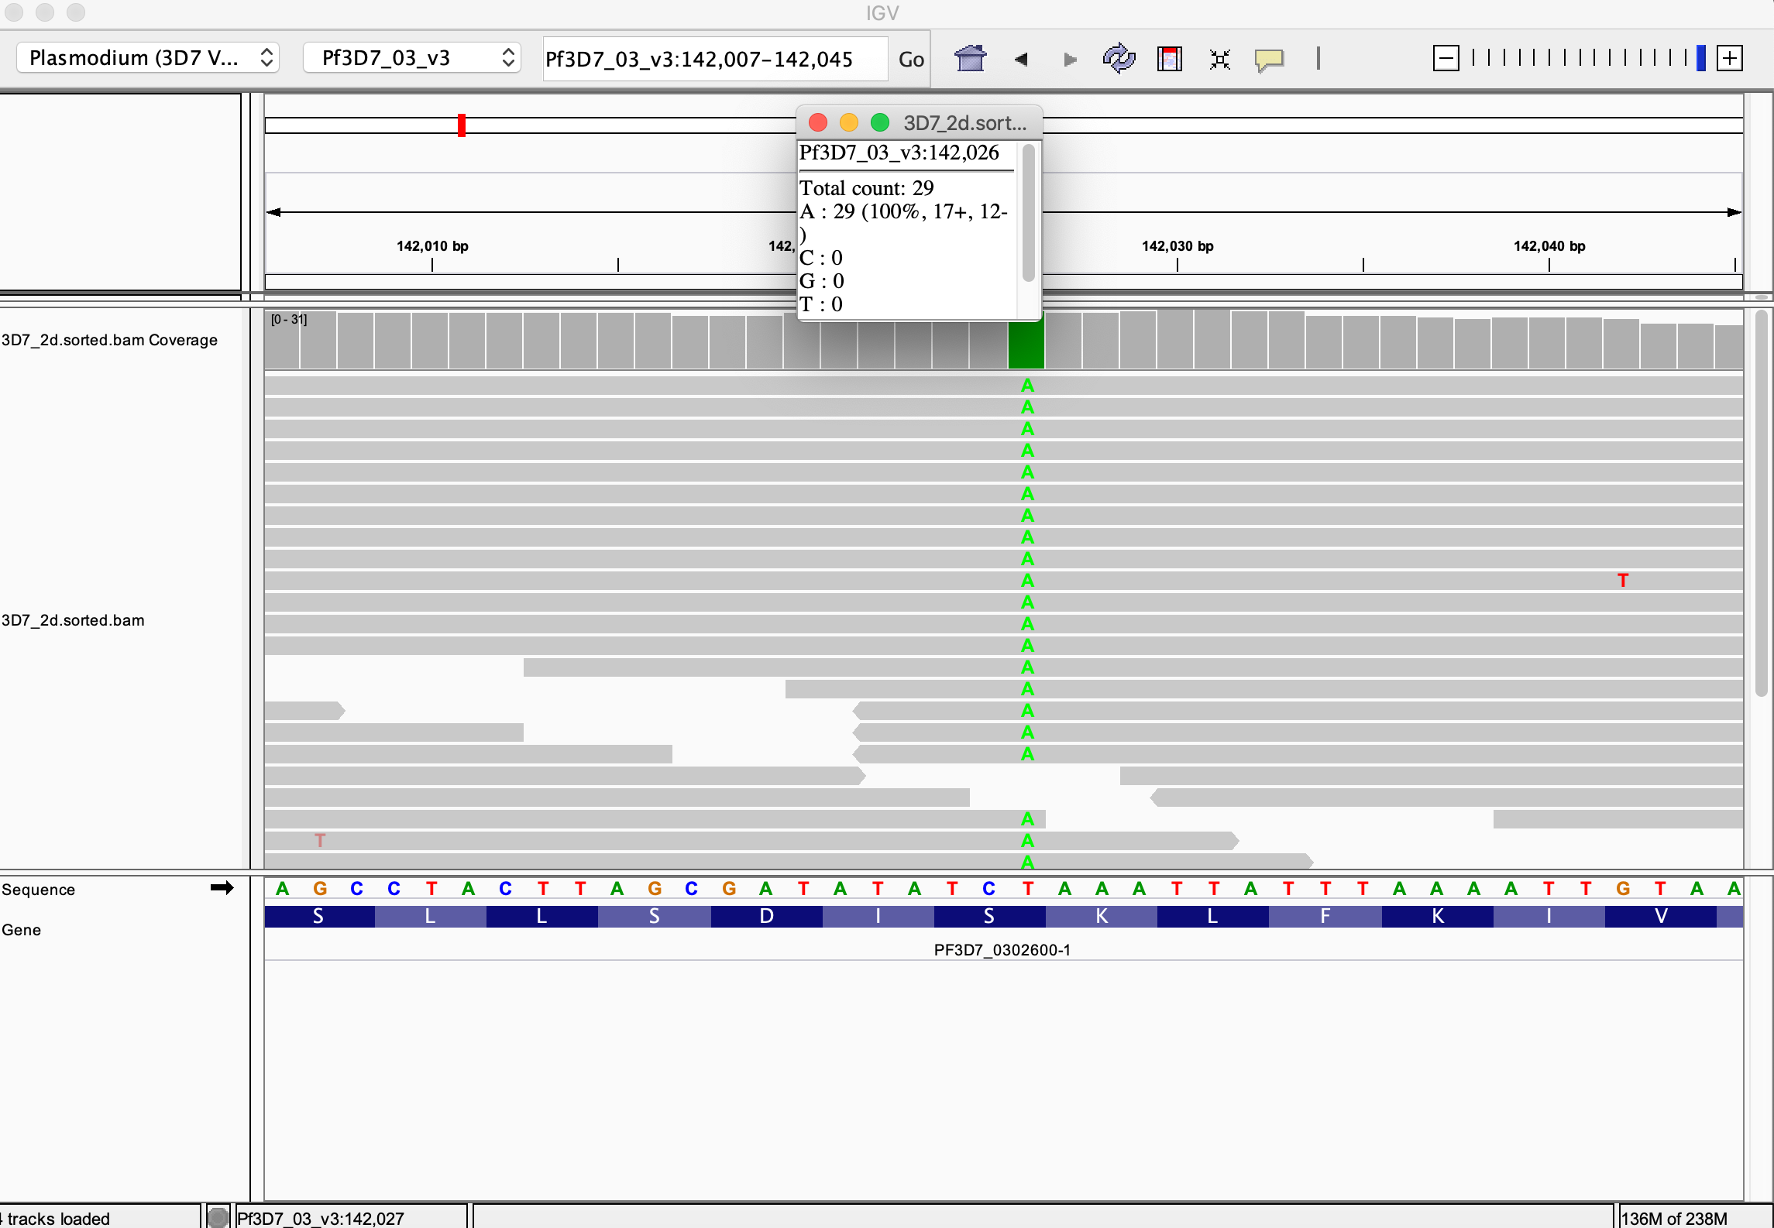
3. Have a look at 3 or 4 SNPs from the list of 192 on a genome browser (chromosome 3). Do they look real, or part of a structural variant?
Almost all of the 192 variants seem to be on 3D7_2d ( This sample does not appear on the figure of the clone trees). The ones I checked seemed pretty real ( of course with a few exceptions like the one on chrom14, that appears to be a result of an indel in the AT repetitive region)
Should I consider 3D7_2d in the analysis? This may be the reason why discovarif worked well for the 1 gen of 3d7 but gave me around 19000 variants after all the filtering when I include the second generation.

Slide 30
4. Check parameters from Romain Coppée and MalariaGEN.
Done! My script is heavily based on Coppée script. Malariagen pipeline is also about the same, regarding the filtering parameters they just mention ‘variants with VQSLOD <=0 were filtered out’. Malariagen does not mention about the the other filters they might have used in detail.

Slide 31
o WITH DISCOVARIF: -3D7 samples: How many True and False SNPs ? (compared to Hamilton)
When done with just 1st gen of 3D7
(includes all the Snps from Hamilton) ( Hamilton had 156 indels identified in 1st generation)
True Snps – need to find the file Out of 7, 1 matched with Hamilton but had different mapped alt and . ref as it is in a highly repetitive region
When done with both the generations of 3D7-
-W2 samples: How many True and False SNPs ? (compared to Hamilton and genome browser for indels )
8/11 match with Hamilton
1 found in Hamilton but does not fit my criteria
There might be 2 new SNPs
195 variants
187 SNP
7 INDELS
18066 variants
15429 SNPs
2637 INDELS
1380 variants
1365 SNPs
14 INDELS

Slide 32
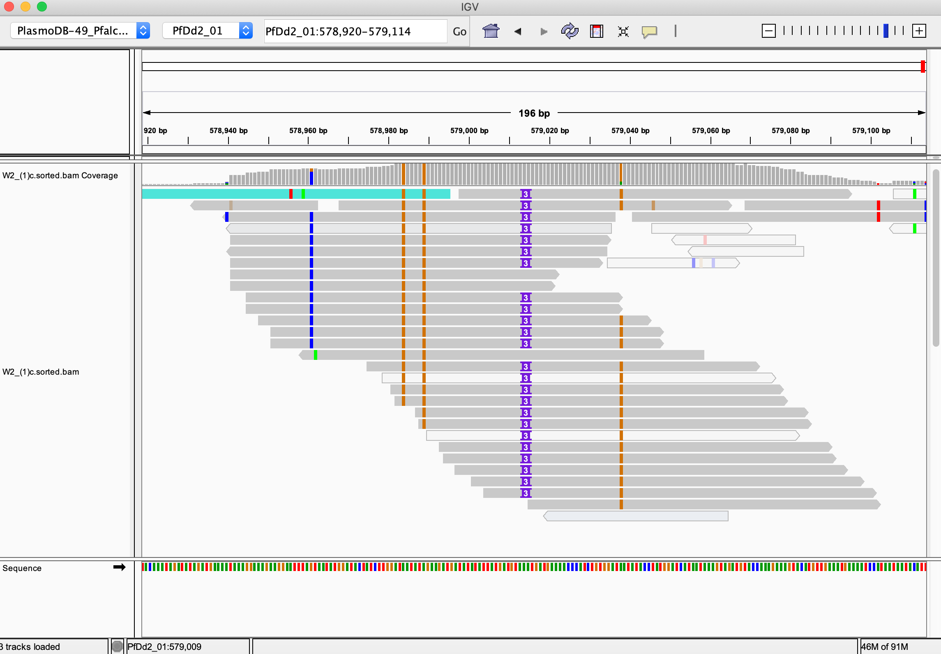
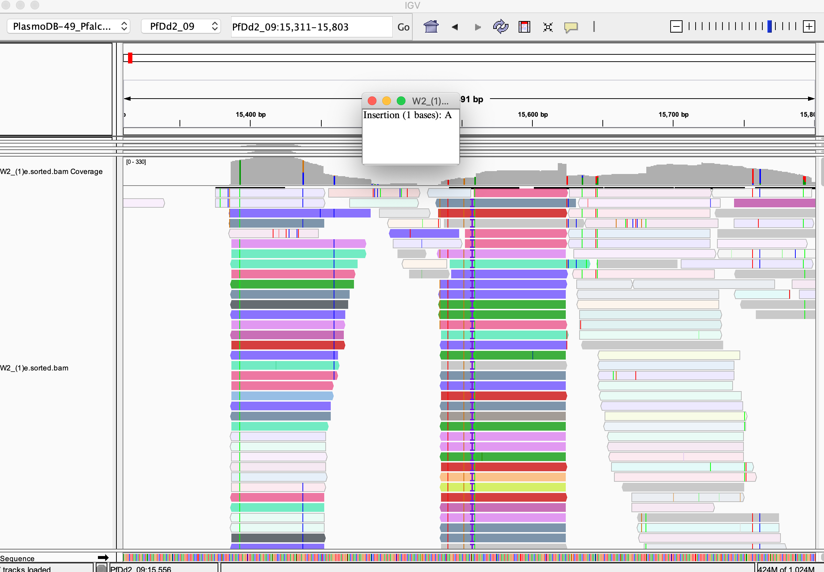
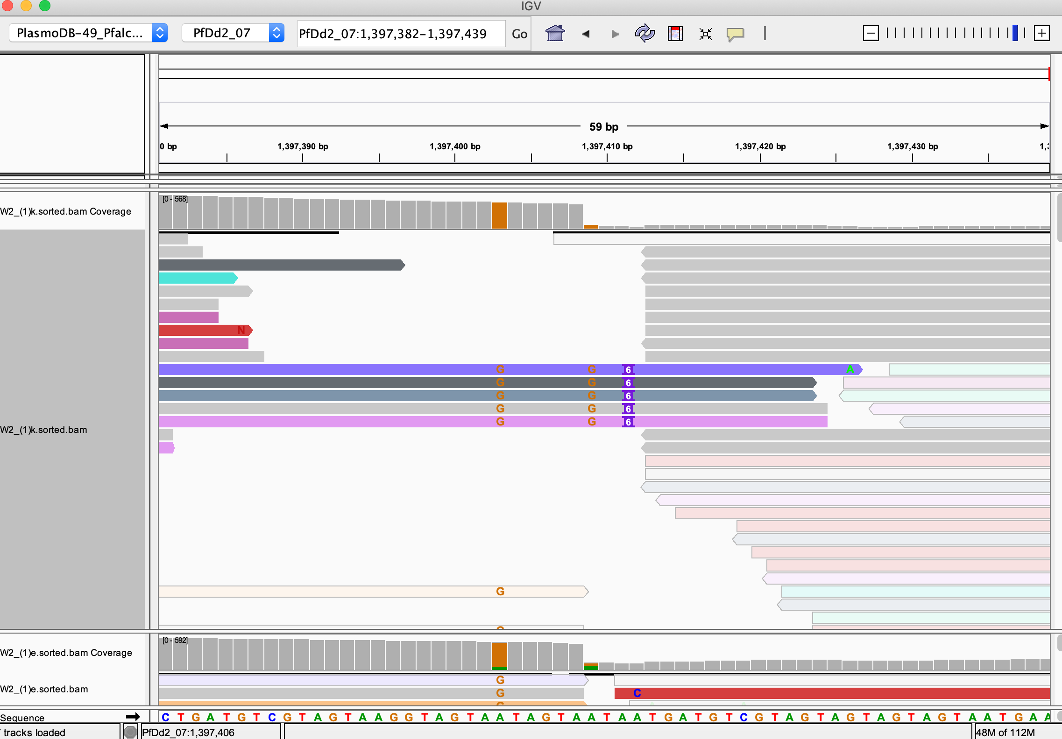

Slide 33
15th January, 2020
1. Try a ‘mixture’ batch of samples: all 3D7 gen1 plus one W2 BAM file. Run the full pipeline with known sites. How many True/False variants do you identify? Use AD (allele Depth) instead of GT. Calculate Ref / Alt +Ref.
It has improved things! But 4 variants are missing. AD column might help.
For this, AD gave me the same results as GT. R script is ready. Didn't really improve things! The missing sites are not given by Gatk .From about, 44000 variants able to filter the list of 113 variants which include the true ones. The remaining one are not present in the file after the genotyping step.

Slide 34
2. How many core / non-core variants do you get? What happened to the column indicating the Core / Hypervariable region? o => Marc-Antoine to help to troubleshoot
Received the bed file from Marc. Added core as the third column. Zipped and indexed the bed file using tabix. Now the error reads “Could not parse the file 3D7-core-perbase.bed.gz, using the columns 1,2,3”.

Slide 35
3. Have a look at 3 or 4 SNPs from the list of 192 on a genome browser (chromosome 3). Do they look real, or part of a structural variant? => Discard the 3D7_2d forever
NOTED.

Slide 36
INDELs with GATK approach (with and without the Known Sites), on 3D7 samples (plus one W2).
INDELS checked in all 34 samples, only 7 of approx. 4880 matched with 165 Indels in Hamilton 2016.
Indels checked in 3D7 gen 1 + w2, has a lot of indels with more than one alternate. Need to fix the make changes to the r script to fix that.
o Worth troubleshooting Discovarif for Indels?
I did not troubleshoot the Discovarif pipeline yet.

Slide 37
25th January,2021
UNIFIED GENOTYPER
HAPLOTYPE CALLER
(--pcr-indel-model NONE --sample-ploidy 1)
After genotyping
4323 variants*
After SelectVariants and VariantFiltration
After VCFtools
INDELS 1078
131/164 match with Hamilton
Filtering according to AD
INDELS- 182
INDELS 1128*
92/164 match with Hamilton
After genotyping
8342 variants*
After SelectVariants and VariantFiltration
After VCFtools
INDELS-2808
SNPs - 2532
Filtering according to AD
INDELS- 1503 (0.4 and 0.6)
SNPs – 481 (0.2 and 0.8)
INDELS – 2869*
SNPs – 2593*
134/164 match with Hamilton
10/15 match with Hamilton
98/164 match with Hamilton
8/15 match with Hamilton
Notes:
Without Known sites ( said that it didn’t recognize the variable QD AD etc. while Variant Recalibration, so skipped it)
The smaller number of sites is not due to filtering, they are not detected after genotyping.
The number that I quickly checked cheks if a mutation is present in only one and only sample across all the samples from all generations.

